Slide 1

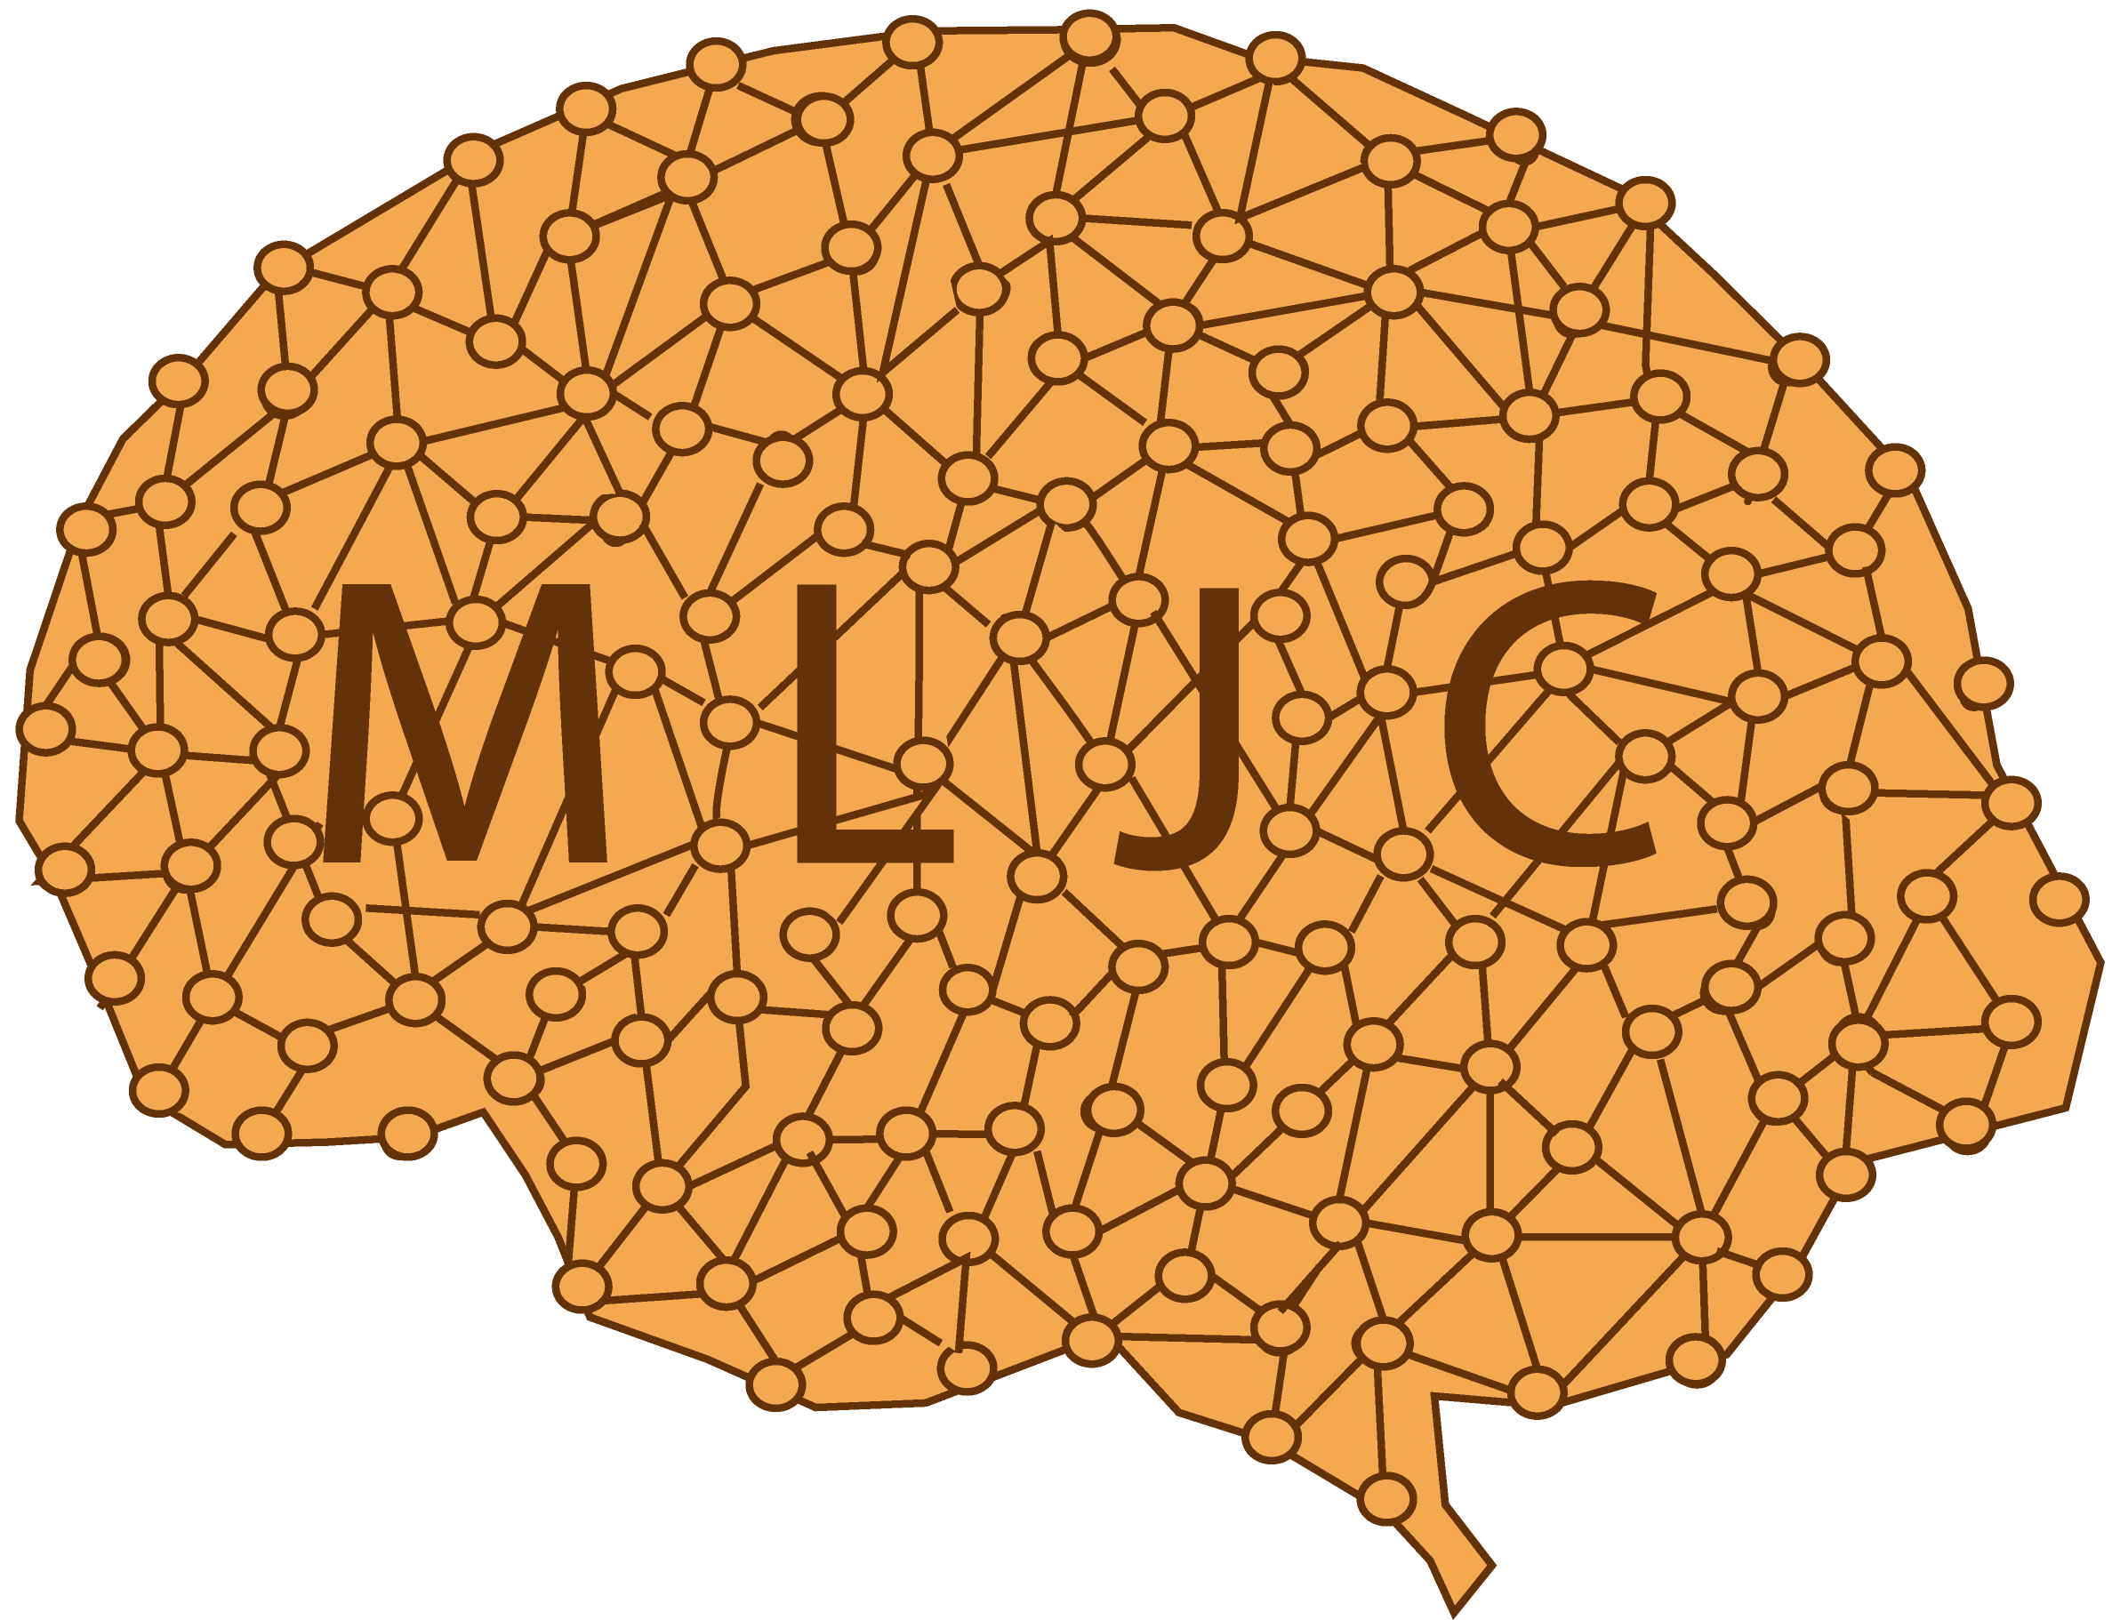
Machine Learning Journal Club: Open Learning for Open Science
Simone Azeglio
Jacopo Pasqualini
simone.azeglio@edu.unito.it
jacopo.pasqualini@edu.unito.it
Machine Learning Journal Club
February 18, 2020

Slide 2
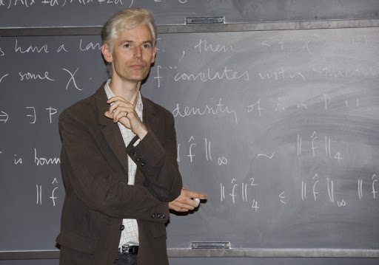

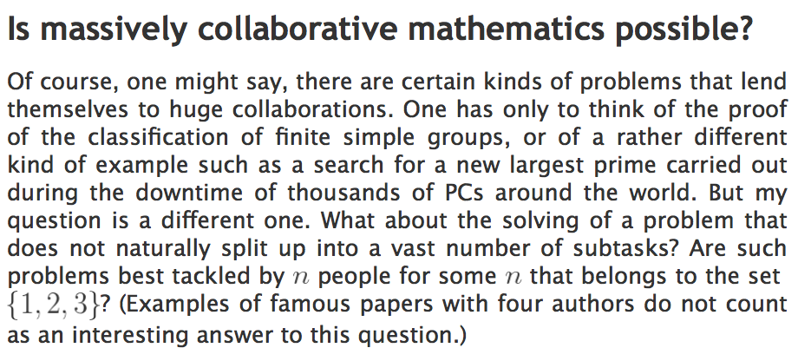


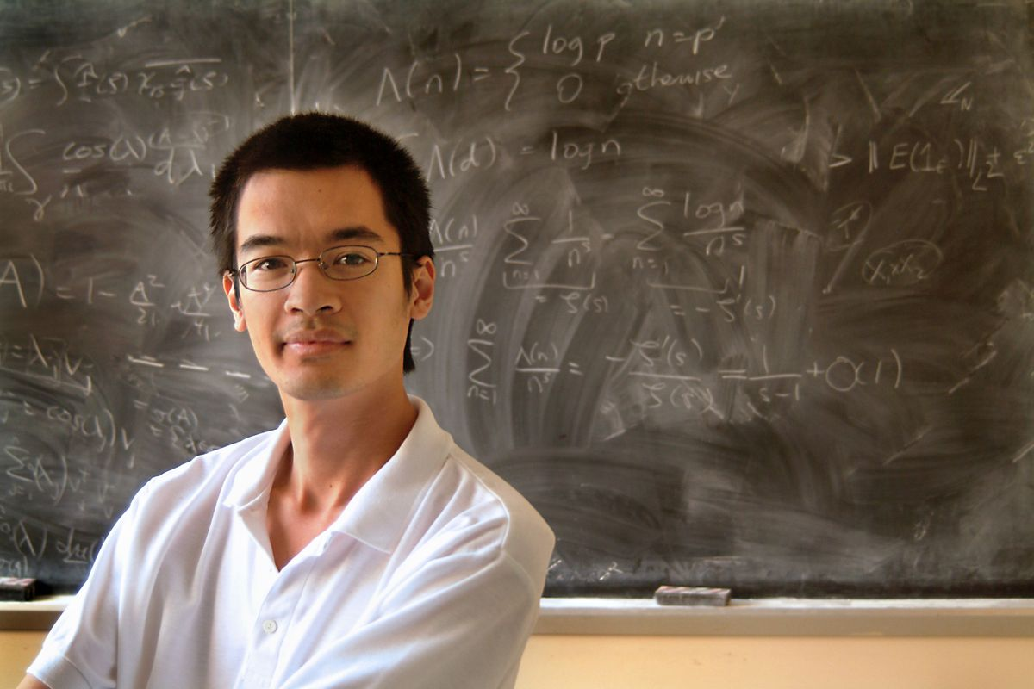
Open Science: is Polymath Project a New Paradigm?
Tim Gowers
Is massively collaborative mathematics possible?
Terence Tao
https://www.scientificamerican.com/article/problem-solved-lol/
Machine Learning Journal Club
February 18, 2020

Slide 3


MLJC: a Contribution to Open Science
MLJC as a learning experience: Machine Learners
Python for Scientific Computing
Hands On Machine & Deep Learning
Machine Learning Journal Club
February 18, 2020
Notes:
Qui mettere didattica → Machine Learners

Slide 4
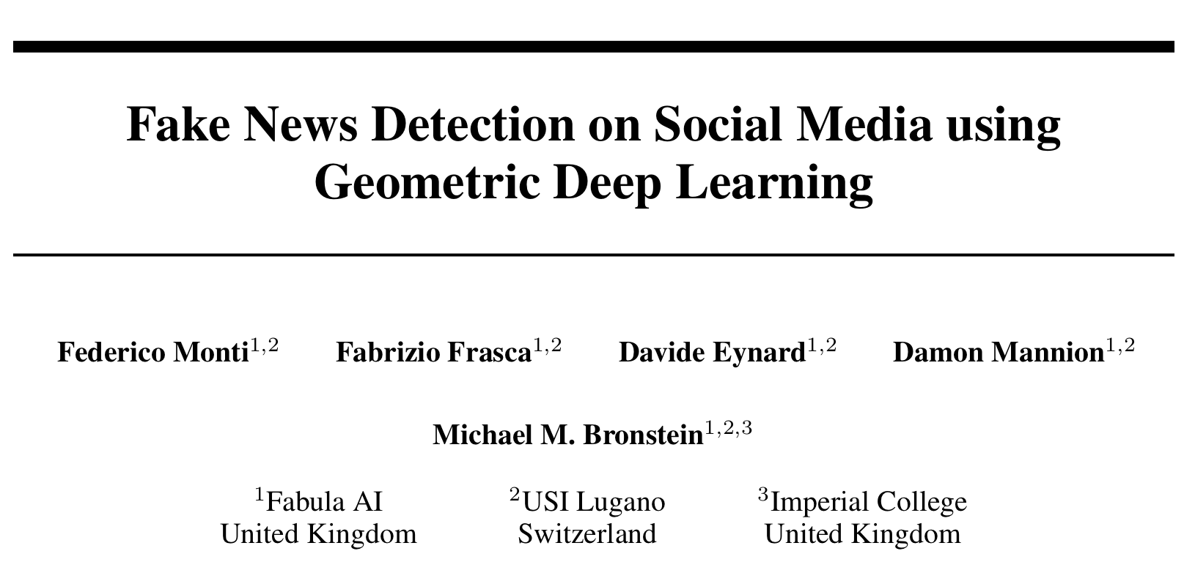
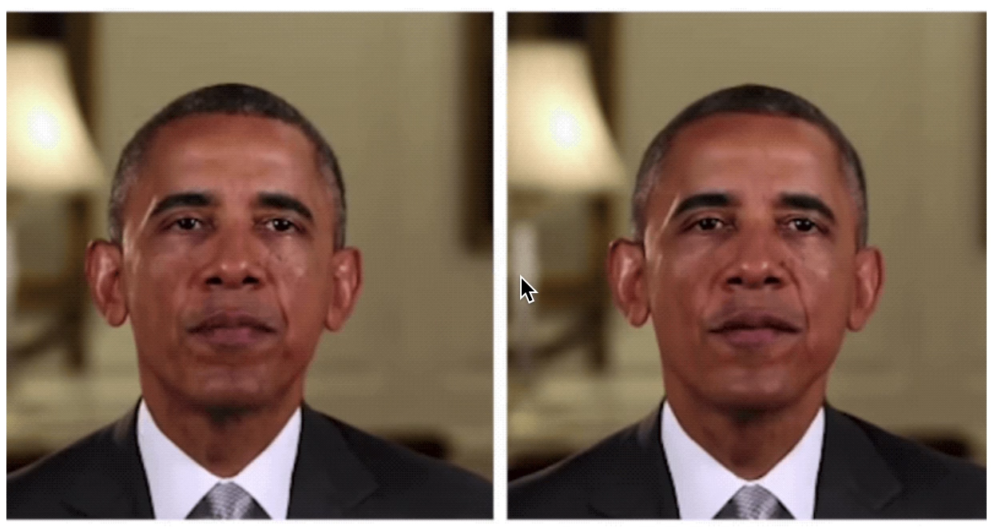
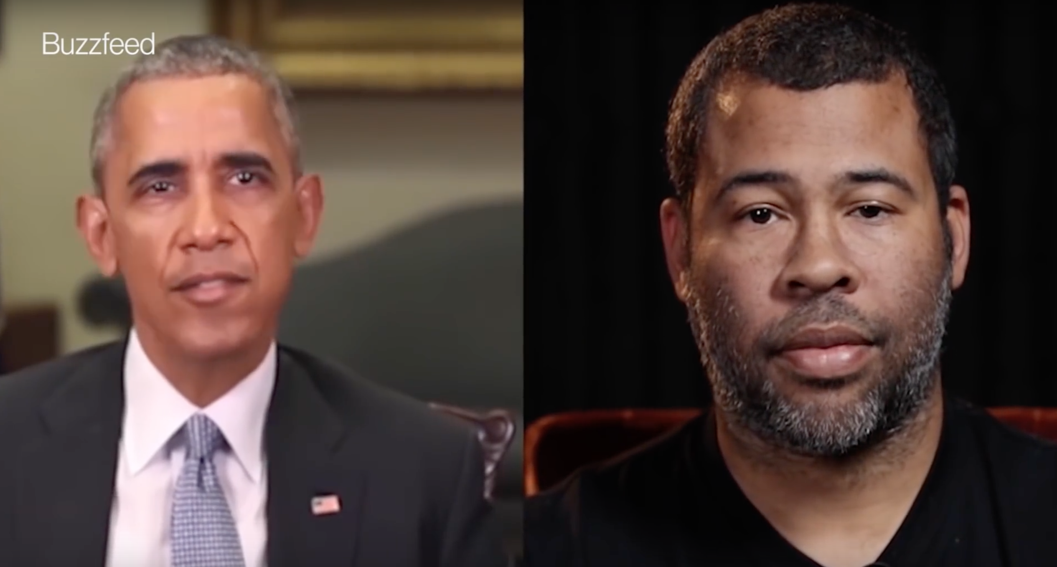



MLJC: a Contribution to Open Science
MLJC as a research experience: Social Resistance
A "quantitative" way to understand and explain reality when Fake and Real seem to be mixed up
DeepFakes
FakeNews
https://www.bbc.com/news/technology-51497800
Real
Fake
Machine Learning Journal Club
February 18, 2020

Slide 5
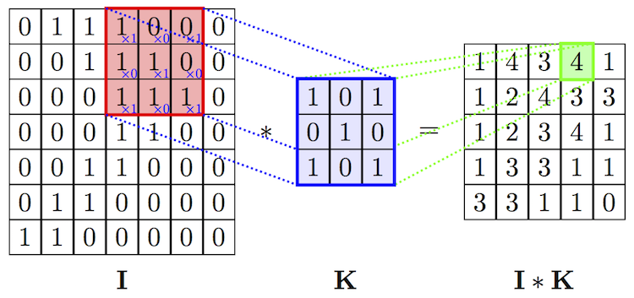
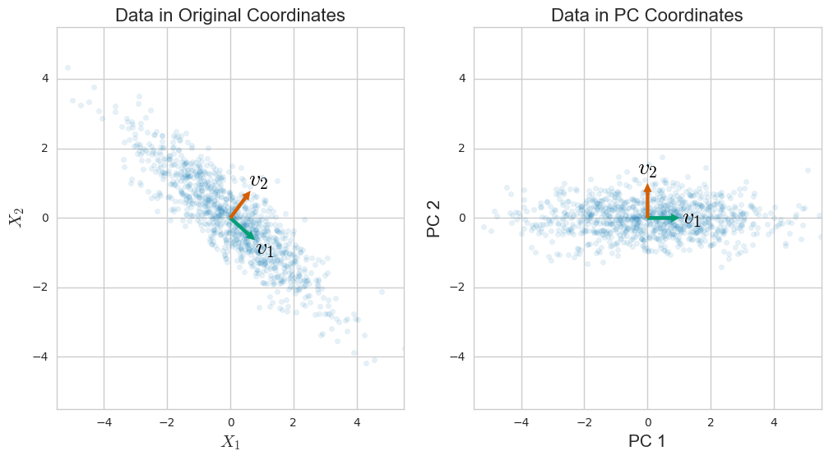
Geometric Priors in ML
In ML there is an ubiquitous prior :
data and models are always embedded in a Euclidean space
Convolutional Neural Networks (CNN)
Principal Component Analysis (PCA)
Machine Learning Journal Club
February 18, 2020
Notes:
5

Slide 6
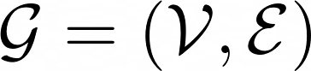
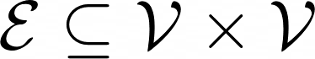
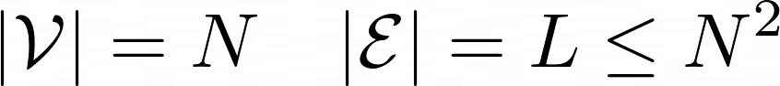
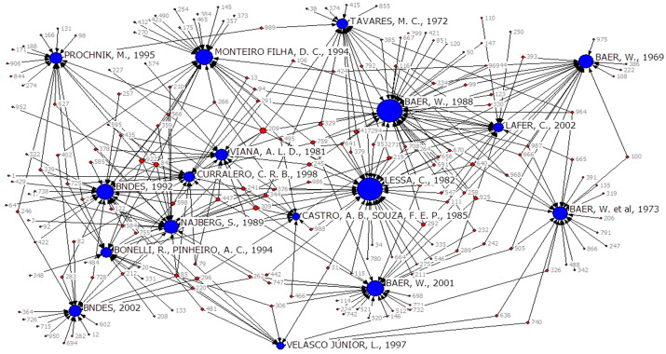
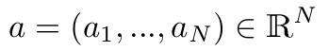
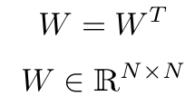
Non Euclidean Data: Graphs
Why?
A lot of real data can be represented
or are embedded in structures
like Manifolds or Graphs
Can we define Convolution on such objects?
Nodes state
Links state
Machine Learning Journal Club
February 18, 2020
Notes:
6

Slide 7
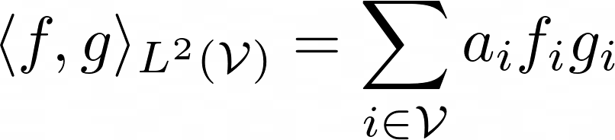
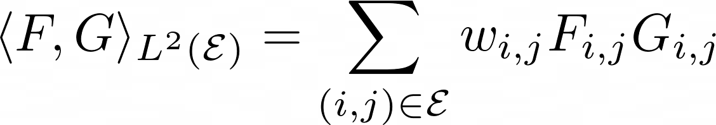
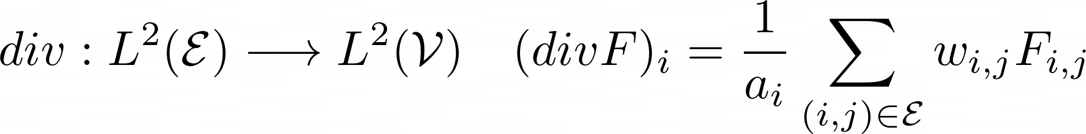
Some Definitions
We can define Hilbert Spaces by introducing inner products of Graph functions
In the same way, operators on such spaces
Machine Learning Journal Club
February 18, 2020
Notes:
7

Slide 8
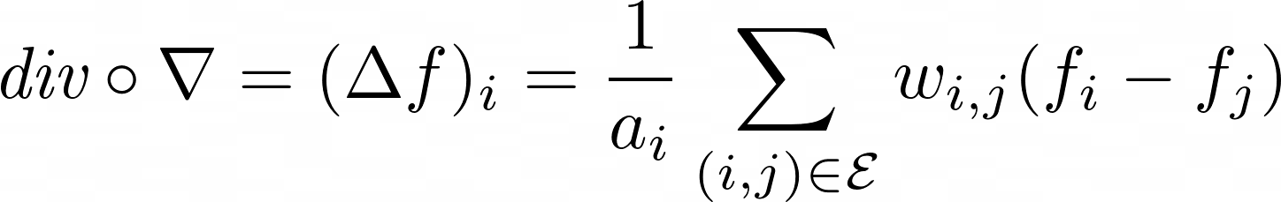
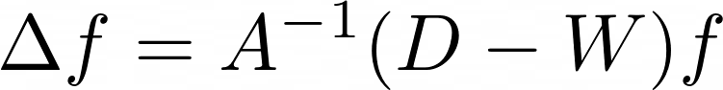
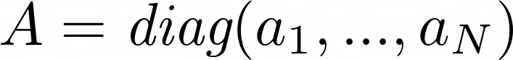
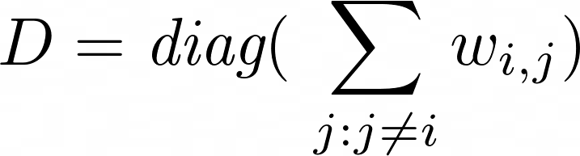
Some Definitions II
We can write the Laplace operator and it’s equation in matrix form
Machine Learning Journal Club
February 18, 2020
Notes:
8

Slide 9
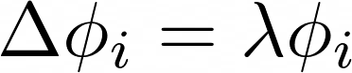
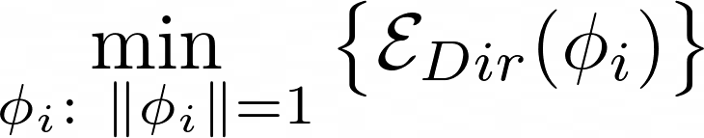
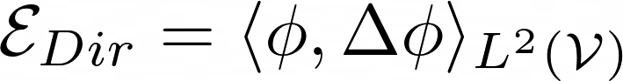
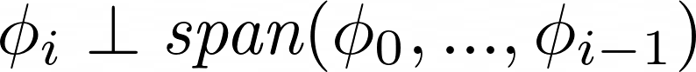
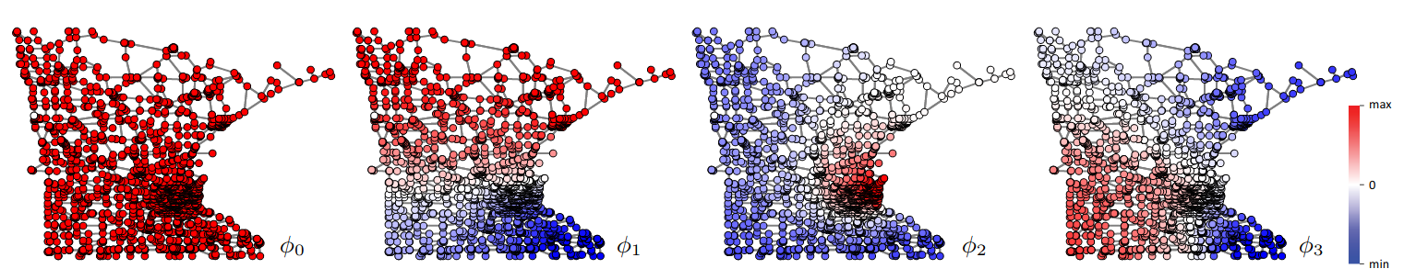
Solving Laplace Problem on Graphs
It is possible to solve the Laplace eigenproblem as an optimization problem :
First four Minnesota road graph eigenfunctions
M.Bronstein et al, IEEE SIC PROG MAG (2016)
Machine Learning Journal Club
February 18, 2020
Notes:
9

Slide 10
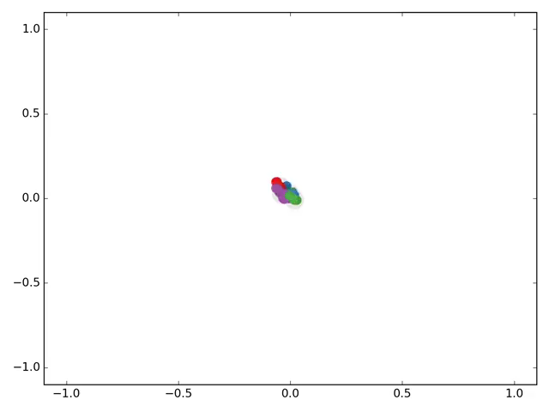
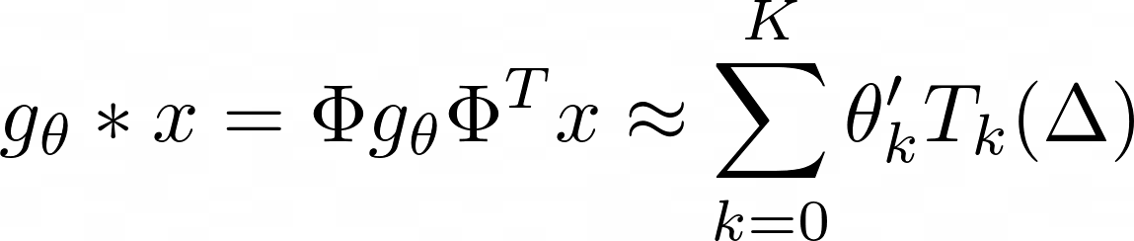
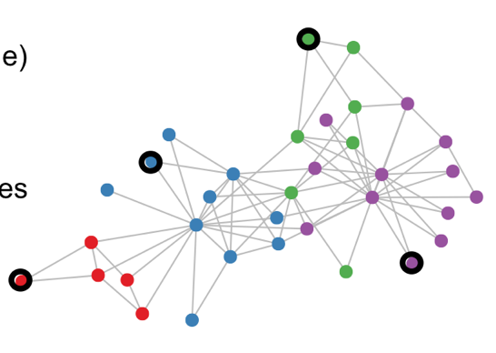
Convolution on Graphs
And use these results to design CNNs that work on graphs
The
End
Spectral Convolutional Layer (1st order approx.)
e.g. Zachary’s Karate Club
Machine Learning Journal Club
February 18, 2020
Notes:
10

